Slide 1


Thinking About…Life After High School
Job Shadow ~ 2019

Slide 2
Common Career Planning Obstacles…
FROM YOUR PEERS:
“No idea what I want to do.”
“It’s hard to pick just one career!”
“What if I pick a career and I’m bored?”
“I have a career in mind, but I don’t know how to get there.”
OTHER REASONS…
Don’t understand what the job is actually like
Not much exposure to a variety of careers
Unclear about what you want from your career
Possibly a lack of support in making life plans

Slide 3

Why a Job Shadow?
Test your assumptions: is the job really what you thought it would be?
Will the job allow for the lifestyle you envision?
Figure out your next steps: either further pursuit of this particular job, or consider other career options
Notes:
Examples: cops don’ t do what they do on TV. What I really want is a job where I can wear cute shoes. Also, athletic trainers work during games.

Slide 4
Job Shadowing at West Central
All Juniors thru English III.
Parent/school permission EACH time you shadow
Shadowing availability based on business.
Fall Semester
Notes:
Do the sample job shadow questions; ask teacher & me – give kids sample questions to ask us.

Slide 5
Sample Job Shadows…
Nurse
Software Engineer
Construction Worker
Occupational Therapy
Speech Pathologist
Ultrasound technician
Marketing Specialist
Electrician
Interior Design
Diesel Mechanics
Sports Trainer
Chef
Many, many more!
Notes:
Think about your interests, but also thing about things you value, and things that are meaningful to you. Do you need all of your values to be reflected in your work? Or is your work going to give you the money you need to live a life that reflects your values?
Example: Mechanical engineer – went back to school to become ortho. Chem Engineer who now teaches at a college & makes wine at her farm.

Slide 6
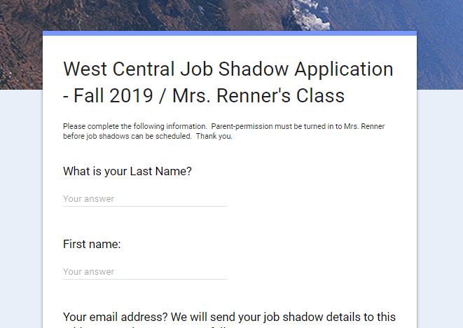
How to Get Started?
Mrs Renner’s Homepage has everything you need to get started.
Today, let’s start with the application!
Parent/guardians will receive a similar application.

Slide 7
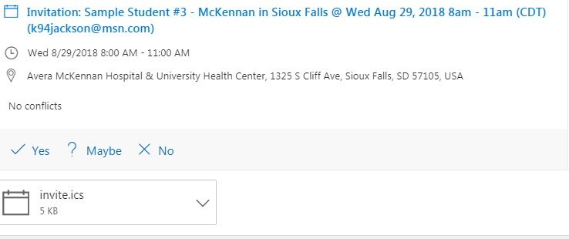
What happens after my shadow is scheduled?
1. Watch your email for details! Example:
2. Open the email to see the DATE and TIME of your appointment:
Be sure to RSVP!

Slide 8
How will I know what to expect?
Everything you’ll need to know is in your email invitation. Here’s an example:

Slide 9
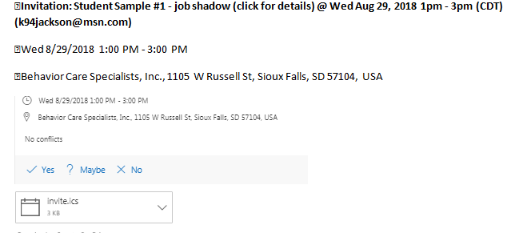

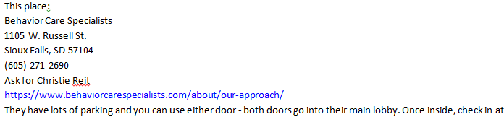
Another Sample Job Shadow: Counseling
Scroll through the entire invitation so you get all of the details!
Notes:
This is a sample form that the student receives, showing all of their details for the day.

Slide 10

Think of your Job Shadow as a Gift!
Spending a few hours in a “shadow” can save you tons of money and hard work later.
Treat your business mentor with courtesy and respect. For example, call if you can’t make it. Show up on time. Be prepared!
Make the most of your mentor’s gift of time by asking questions.
Express gratitude when you leave and send a note of thanks…even if you won’t pursue that career!

Slide 11
Job Shadows – Odds & Ends
Some career fields have limited availability for shadowing during certain times of the year (Ex: Game, Fish & Parks, Accounting, etc)
Hospitals require proof of a flu shot prior to shadowing (Oct 1 – March 31)
Some organizations will require an additional application (Avera, Daktronics, etc)
Be sure to double-check your sports schedule before scheduling your job shadow! Avoid preventable rescheduling.
Some organizations only offer ‘group’ shadows (ex: law enforcement). We will organize those groups for your school.
Notes:
Think about your interests, but also thing about things you value, and things that are meaningful to you. Do you need all of your values to be reflected in your work? Or is your work going to give you the money you need to live a life that reflects your values?
Example: Mechanical engineer – went back to school to become ortho. Chem Engineer who now teaches at a college & makes wine at her farm.

Slide 12
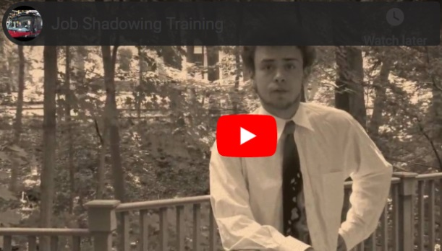
What to Wear?
Review your Email Invitation – each shadow is different.
BLEND IN!!! Look as if you could be working there.
Manage 1st impressions. Many shadows have turned into jobs/internships/referrals.
Cell phones off & stashed.
Consider pen / notepad
Notes:
The hospitals have the strictest policies, so we use as a starting point. From there, we discuss differences in dress code for a variety of career fields. For example, veterinarians typically suggest that the students bring boots, gloves, etc., in case they are outside. Mechanics typically get dirty on the job, so we talk about how t-shirts need to have “clean language”, jeans shouldn’t have holes, etc.

Slide 13


Dress Code - Definitions
Professional Dress – “Suits”. Or, dressier pants with shirt/tie or blouse.
Business Casual Dress – Collared shirt with pants or nicer jeans. Casual skirt, capris, leggings, dressy jeans, etc.
Every Day Dress – Nicer school clothes. Should still be clean, tucked in, no ripped clothing, no questionable language. Avoid low cut clothes. Dress for the weather if your job shadow takes place outdoors.
Notes:
TELL SHERIFF story – they thought the shadow student was someone the sheriff’s picked up for bad behavior!

Slide 14
Etiquette / Safety on the Job Shadow
Remember, some dress codes are for your SAFETY (OSHA). (Examples: piercings, long hair, rings, etc)
When you are ready to leave, make sure you notify the business. Thank the organization for their time and energy, even if you don’t think you’ll pursue the career.
Avoid using your cell phone during the job shadow. Please keep notifications turned off for the few hours you are there.
Notes:
Again – taken strictly from Sanford, but good advice for any shadowing experience. Students typically ask about facial piercings…I tell them that we respect the business’s dress code policy because they are doing us a favor by opening their doors to the students. However, later on, when a student is actually searching for a job/career, then they might want to pursue employment with a company that matches their personal style.

Slide 15


Slide 16

Avoid these…
Too much skin! (shorts, tanks, low-cut)
Hats (bring for outdoors only)
Athletic wear
Visible straps

Slide 17
What Will You Talk About?
Sample Questions:
What did you do before this job?
How can I get some experience in this field?
Would you choose the same occupation again if you were just starting out? Why/why not?
What is your favorite thing about your job?
What is the interview process like for this job?
What other jobs could I get into with this same background?
Are there other jobs that you would suggest for me to explore as alternative to this one?
(At the end of your shadow) Would it be okay for me to contact you later if I have other questions?
Notes:
Sample questions…it’s a good idea to research the career prior to the visit, and then use that time to ask more educated questions about the job.

Slide 18
Send a thank you note ASAP!
Sept 26, 2019
Ms. Pamela Jones
Marketing Specialist
Any Organization
Post Office Box 12345
Sioux Falls, SD 57104
Dear Ms. Jones:
Thank you for taking the time to answer my many questions and for allowing me to shadow you yesterday. I enjoyed meeting you and learning more about the marketing field. It was especially helpful to visit your company and receive a tour of the Marketing Department.
Your explanation of the differences and similarities between advertising, marketing, and public relations was most helpful. I had not previously realized there were so many varied industries in which to apply my skills and interests, including the Non-Profit Administration arena. This experience really opened my eyes!
I appreciate your time and advice, and thank you for all your career tips on the marketing field.
Sincerely,
Star Shadowing Student (Signature)

Slide 19

Some final tips…
Be ready for anything! Enthusiasm can shape your experience.
Admit it if you don’t know something…
Be on time
Show appreciation!
Video:

