Slide 1
Thinking About…Life After High School
Job Shadow ~ 2018

Slide 2
Common Career Planning Obstacles…
FROM YOUR PEERS:
“No idea what I want to do.”
“It’s hard to pick just one career!”
“What if I pick a career and I’m bored?”
“I have a career in mind, but I don’t know how to get there.”
OTHER REASONS…
Don’t understand what the job is actually like
Not much exposure to a variety of careers
Unclear about what you want from your career
Possibly a lack of support in making life plans

Slide 3
Why a Job Shadow?
Test your assumptions: is the job really what you thought it would be?
Does the job provide the lifestyle you envision for yourself?
Learn about the job from an insider.
Figure out your next steps: either further pursuit of this particular job, or consider other job options
Notes:
Examples: cops don’ t do what they do on TV. What I really want is a job where I can wear cute shoes. Also, athletic trainers work during games.

Slide 4
Job Shadowing at West Central
All Juniors thru English III.
Parent/school permission EACH time you shadow
Shadowing availability based on business.
Notes:
Do the sample job shadow questions; ask teacher & me – give kids sample questions to ask us.

Slide 5
Sample Job Shadows…
Nurse
Meteorologist
Construction Worker
Occupational Therapy
Speech Pathologist
Ultrasound technician
Manager
Electrician
Interior Design
Diesel Mechanics
Sports Trainer
Chef
Many, many more!
Notes:
Think about your interests, but also thing about things you value, and things that are meaningful to you. Do you need all of your values to be reflected in your work? Or is your work going to give you the money you need to live a life that reflects your values?
Example: Mechanical engineer – went back to school to become ortho. Chem Engineer who now teaches at a college & makes wine at her farm.

Slide 6
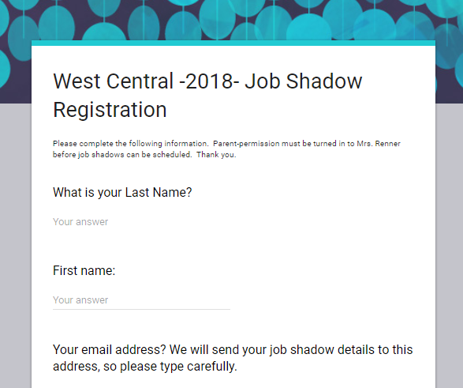
How to Get Started?
Mrs Renner’s Homepage has everything you need to get started.
Today, let’s start with the application!

Slide 7
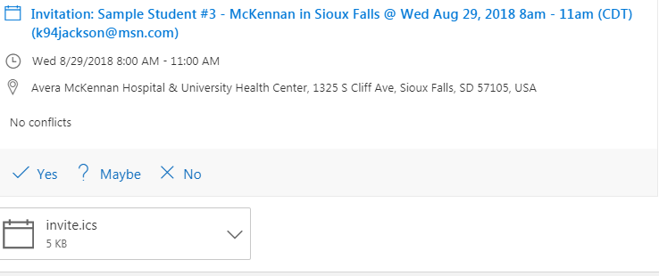
What happens after my shadow is scheduled?
1. Watch your email for details! Example:
2. Open the email to see details and to RSVP. Example:

Slide 8
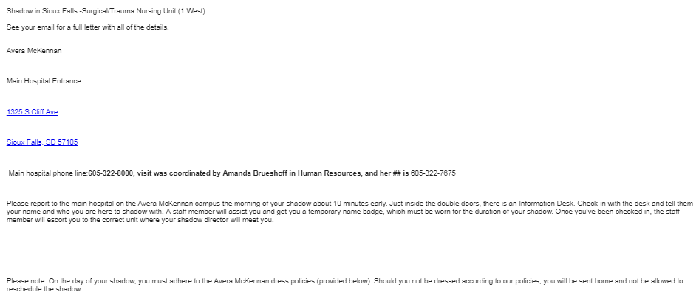
How will I know what to expect?

Slide 9
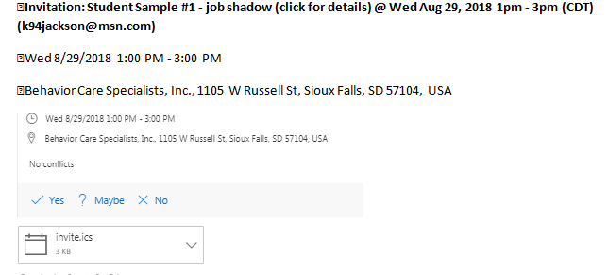
Another Sample
Scroll through the entire invitation so you get all of the details!
Notes:
This is a sample form that the student receives, showing all of their details for the day.

Slide 10
Think of your Job Shadow as a Gift!
Spending a few hours in a “shadow” can save you tons of money and hard work later.
Treat your business mentor with courtesy and respect:
Call if you can’t make it. Show up on time. Be prepared!
Make the most of your mentor’s gift of time by asking questions.
Express gratitude when you leave and send a note of thanks…even if you won’t pursue that career!

Slide 11
Job Shadows – Odds & Ends
Certain careers are only available for shadowing at certain times of the year (Ex: Warden)
Hospitals require proof of a flu shot prior to shadowing (Oct 1 – March 31)
Avera has an additional online application for shadowing. Ask me for the link.
Be sure to double-check your sports schedule before scheduling your job shadow! Avoid preventable rescheduling.
Some organizations only offer ‘group’ shadows (ex: law enforcement). We will organize those groups for your school.
Notes:
Think about your interests, but also thing about things you value, and things that are meaningful to you. Do you need all of your values to be reflected in your work? Or is your work going to give you the money you need to live a life that reflects your values?
Example: Mechanical engineer – went back to school to become ortho. Chem Engineer who now teaches at a college & makes wine at her farm.

Slide 12
What to Wear?
Review your Email Invitation – each shadow is different.
BLEND IN!!! Look as if you could be working there.
Shoes matter! Avoid heels. Many workplaces require covered toes.
Manage 1st impressions. Many shadows have turned into jobs/internships/referrals.
Cell phones off & stashed.
Notes:
The hospitals have the strictest policies, so we use as a starting point. From there, we discuss differences in dress code for a variety of career fields. For example, veterinarians typically suggest that the students bring boots, gloves, etc., in case they are outside. Mechanics typically get dirty on the job, so we talk about how t-shirts need to have “clean language”, jeans shouldn’t have holes, etc.

Slide 13
Job Shadow: Safety & Manners
No facial piercings for shadows.
Remember, some dress codes are for your SAFETY! (OSHA). This could include limiting the amount of jewelry you wear, or avoiding open-toed shoes or high heels. Likewise, long hair should be pulled back for manufacturing & healthcare (otherwise, you might have to wear a hair net). ☺
No gum please!
When you are ready to leave, make sure you notify the business. Don’t just disappear. They might have other people lined up for you for later in the day. Make sure you thank them for their time, even if the career ended up not being something that you would choose to pursue.
Please DO NOT talk or text on a cell phone during a job shadow experience. Please keep phones turned off for the few hours you are there.
Notes:
Again – taken strictly from Sanford, but good advice for any shadowing experience. Students typically ask about facial piercings…I tell them that we respect the business’s dress code policy because they are doing us a favor by opening their doors to the students. However, later on, when a student is actually searching for a job/career, then they might want to pursue employment with a company that matches their personal style.

Slide 14
Dress Code - Definitions
Professional Dress – Dress Pants and Dress Shirt or a Dress or Skirt and Blouse.
Casual Dress – Khaki Pants and a nice shirt or blouse.
Every Day Dress – Jeans and Shirt or blouse. Should still be clean, tucked in, no ripped clothing, no questionable language. Remember – you could be mistaken for an employee.
Notes:
TELL SHERIFF story – they thought the shadow student was someone the sheriff’s picked up for bad behavior!

Slide 16
Avoid these…
Too much skin! (shorts, tanks, low-cut)
Hats (bring for outdoors only)
Athletic wear
Visible straps

Slide 17
What Will You Talk About?
Sample Questions:
What did you do before this job?
How can I get some experience in this field?
Would you choose the same occupation again if you were just starting out? Why/why not?
What is your favorite thing about your job?
What is the interview process like for this job?
What other jobs could I get into with this same background?
Are there other jobs that you would suggest for me to explore as alternative to this one?
(At the end of your shadow) Would it be okay for me to contact you later if I have other questions?
Notes:
Sample questions…it’s a good idea to research the career prior to the visit, and then use that time to ask more educated questions about the job.

Slide 18
Send a thank you note ASAP!
Sept 26, 2018
Ms. Pamela Jones
Marketing Specialist
Any Organization
Post Office Box 12345
Sioux Falls, SD 57104
Dear Ms. Jones:
Thank you for taking the time to answer my many questions and for allowing me to shadow you yesterday. I enjoyed meeting you and learning more about the marketing field. It was especially helpful to visit your company and receive a tour of the Marketing Department.
Your explanation of the differences and similarities between advertising, marketing, and public relations was most helpful. I had not previously realized there were so many varied industries in which to apply my skills and interests, including the Non-Profit Administration arena. This experience really opened my eyes!
I appreciate your time and advice, and thank you for all your career tips on the marketing field.
Sincerely,
Star Shadowing Student (Signature)

Slide 19
Some final tips…
Be ready for anything! Enthusiasm can shape your experience.
Admit it if you don’t know something…
Be on time
Show appreciation!
Video:

