Slide 1
Native/Early American literature
(aka Myths, Tales, Folktales, Folklore)

Slide 2
Native Americans were on this Continent CENTURIES before Europeans
There were 100s of thriving unique nations
Each had/has its own tradition of literature that was passed down orally
Families kept the tradition going
Ceremonies were another place where oral stories were retold
Myths are an important part of Native American spiritual beliefs
It is unknown where the stories originated
They were written down only in the last 100 years
These stories tell us how the world came to be
Many rely heavily on a reverence of the natural world
http://www.westlake.k12.oh.us/whsteachers/millerla/Multicultural%20Lit_files/Native%20Amer/Native%20American%20Creation%20Myths%20Basic%20Notes.pdf

Slide 3
Telling Stories – Native American Mythology
Myths and rituals play a central role in traditional Native American cultures
They were important in giving people a sense of order and identity.
They gave people a way to ensure food, explain the unexplainable heal the sick, and teach lessons.
Early Native American tribes passed stories down through oral tradition (telling stories verbally instead of writing them down).
As a result of the oral tradition, there are often many versions of a single myth.
Native American myths were often derived from ceremonial songs and prayers, hero tales, explanations of things in nature, migration stories, historical stories, and poems. Most myths were told through oral tradition.
http://www.westlake.k12.oh.us/whsteachers/millerla/Multicultural%20Lit_files/Native%20Amer/Native%20American%20Creation%20Myths%20Basic%20Notes.pdf http:/www.livingmyths.com/Native.htm

Slide 4
Define Myth
Myth–an anonymous oral story
Relies on the supernatural to explain a natural phenomenon, human behavior, or mystery
Purpose
Explains why the world is the way it is/they help make sense of the world
http://www.westlake.k12.oh.us/whsteachers/millerla/Multicultural%20Lit_files/Native%20Amer/Native%20American%20Creation%20Myths%20Basic%20Notes.pdf

Slide 5
Totem
In many cultures, each group, clan or family would be said to descend from an animal or natural object called the totem
Example: the Bear Clan would honor the bear, and it in turn would be their guardian spirit
That group would be largely responsible for maintaining the myth of the bear
The Mohawks had three clans: the wolf, bear, and turtle
People frequently attributed the characteristics of animals to people
Example: bear is strong, dangerous; turtle is reserved methodical
http://www.westlake.k12.oh.us/whsteachers/millerla/Multicultural%20Lit_files/Native%20Amer/Native%20American%20Creation%20Myths%20Basic%20Notes.pdf

Slide 6
Main Types of Native American myths
Creation Myth
Explains how human lives came to exist
Explains the workings of the natural world
Supports and validates social customs
Guides people through the trials of living
Instills a sense of the mystery of the universe and attempts to explain that mystery
Origin Myth
Explains why phenomena like the stars, moon, and sky came to be and why certain animals have certain characteristics
Trickster Myth
A trickster is a crafty creature or being who uses cunning to get food, steal precious possessions, or simply cause mischief. He disrupts the order of things, often humiliating others and sometimes himself. In Native American traditions, the trickster takes many forms.
Heroic Journey Myth
Tells about a commonplace hero who finds himself on a journey filled with supernatural experiences and challenges - which he wins – and returns home with the power to improve his fellow man’s lives.
http://www.indiebound.org/book/9781555917241
http://www.westlake.k12.oh.us/whsteachers/millerla/Multicultural%20Lit_files/Native%20Amer/Native%20American%20Creation%20Myths%20Basic%20Notes.pdf

Slide 7
Trickster Myths
Are important part of Native American mythology
The Trickster is an animal with two sides to its personality
They create trouble and chaos and reveal wisdom
Often is a coyote, a raven or a mink
Main difference between tales and myths: myths were regarded as truth, tales as fiction
Characteristics:
Magic
Trickery
Violence
Purpose:
To explain the origins of some aspect of the natural world and/or teach a lesson
http://www.westlake.k12.oh.us/whsteachers/millerla/Multicultural%20Lit_files/Native%20Amer/Native%20American%20Creation%20Myths%20Basic%20Notes.pdf

Slide 8
Trickster Tales : Key Terms
Animal People –the first inhabitants of the world; spirit beings that could take the shape of human or animal (ie: coyote)
Anthropomorphism–giving human behavior, characteristics, or motivations to inanimate objects, animals, or natural phenomena.

Slide 9
Emphasis on the Spiritual
Native American myths often emphasize a strong spiritual bond between the creator, humanity and the natural world.
It’s the duty of humanity to maintain a balance between these entities.
Among all tribes there is a strong sense that behind all individual spirits and personifications of the divine, there is a single creative life-force, sometimes called ‘the Great Mystery’, which expresses itself throughout the universe, in every human, animal, tree and grain of sand.

Slide 10
Role of Animals in Native American Myths
Animals often speak to humans and assist them.
Most tribes thought that individual members of a species embodied a particular spirit power.

Slide 11
Role of the Four Directions in Native American Myths
• The Four Directions (North, South, East, West) are often given powers, which occur either literally or in symbolic form throughout the stories.
often represented by particular colors, or by animals.
All Four Directions must be in balance for all to be well with the world.

Slide 12
Rhythm and Native American myths
Native Americans often used rhythm to help them remember their very long stories
Drums and cymbals were used as aids
Also believed that the drum repetition could enable the singer to communicate with the world of animals, nature, and spirits

Slide 13
Recurring ideas among (even unconnected) Native American groups
Humans have a connection with nature
Conflict between ancient customs and modern life, past and present
Storytelling is important (“The Storyteller…”)
Life as a circle
Fire as a symbol

Slide 14
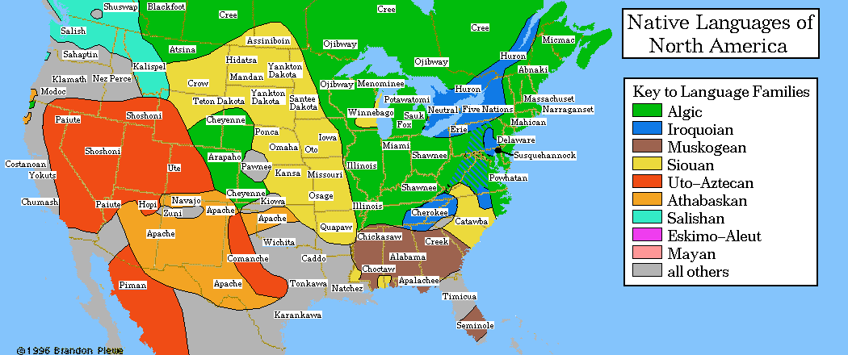

Slide 15
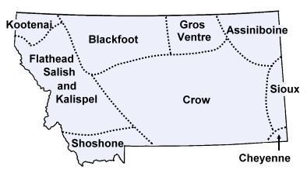
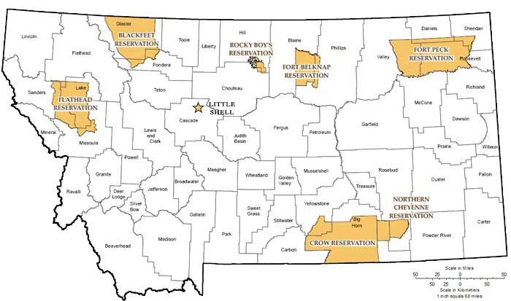

Slide 16
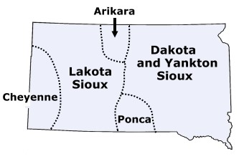
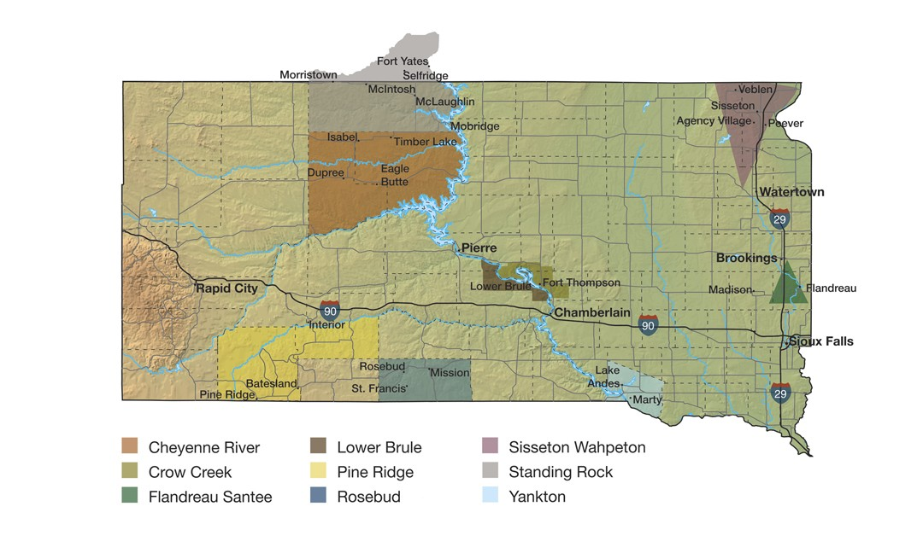

Slide 17
http://www.youtube.com/watch?v=BNY7L_RdObA

